Slide 1

Predicting customer buying behaviour
Sodiq Gbadebo-ogunmefun
20/09/2023

Slide 2
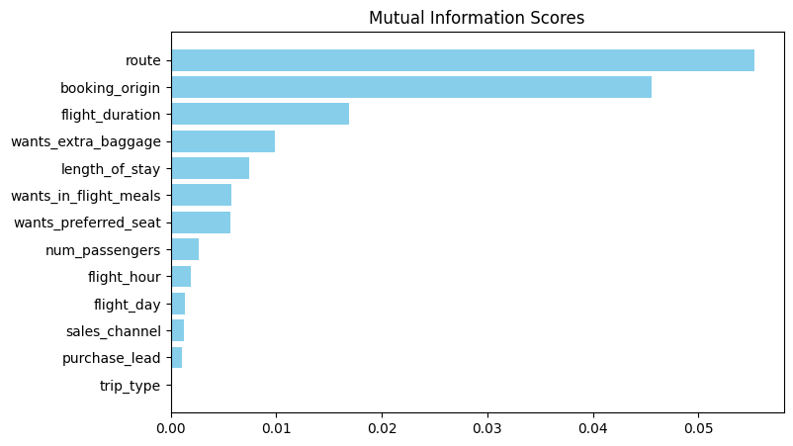
model evaluation and present findings
The Random-Forest classifier model was adopted to train the dataset.
Here are the performance results:
FIT TIME: 85.052sec
ACCURACY: 85.3%
PRECISION: 55%
RECALL: 70%
The chart shows the top features which have
the most importance in determining
Customer buying behavior .
The route feature can be seen to be
the most important feature.

